Slide 1


DIGITAL MODULATION TECHNIQUES WITH REAL-WORLD APPLICATIONS
Presented by:Om Shinde
Anuj Shinde
Dhananjay Sharma
Pratik Shinde

Slide 2

Contents
Introduction
Amplitude Shift Keying (ASK)
Frequency Shift Keying (FSK)
Phase Shift Keying (PSK)
Comparison and Conclusion

Slide 3
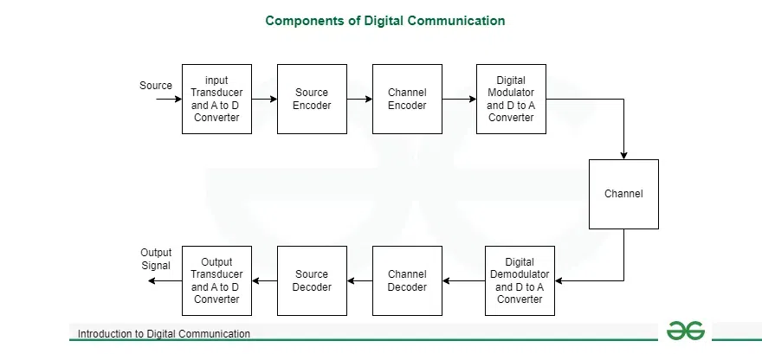
Introduction
Digital modulation is the process of converting digital data (binary bits 0 and 1) into an analog waveform by varying one or more characteristics of a carrier signal — such as its amplitude, frequency, or phase — to enable transmission over communication channels.
It allows efficient, noise-resistant wireless communication.
Common digital modulation techniques include:
ASK (Amplitude Shift Keying)
FSK (Frequency Shift Keying)
PSK (Phase Shift Keying)

Slide 4
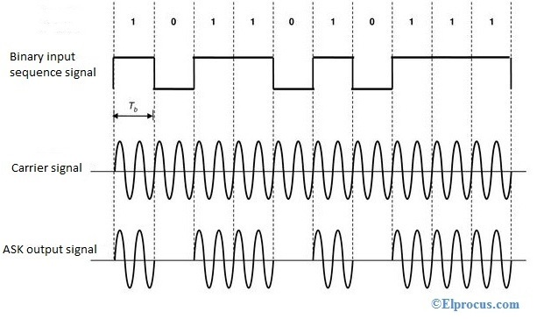
Amplitude Shift Keying (ASK)
In ASK, the amplitude of the carrier wave changes according to digital data.
A binary ‘1’ turns the carrier ON, and ‘0’ turns it OFF.
It is simple and cost-effective but sensitive to noise.
Real-World Example:
RFID Tags use ASK to transmit stored ID data to RFID readers through electromagnetic coupling.
Formula: s(t)=Amcos⁡(2πfct)

Slide 5
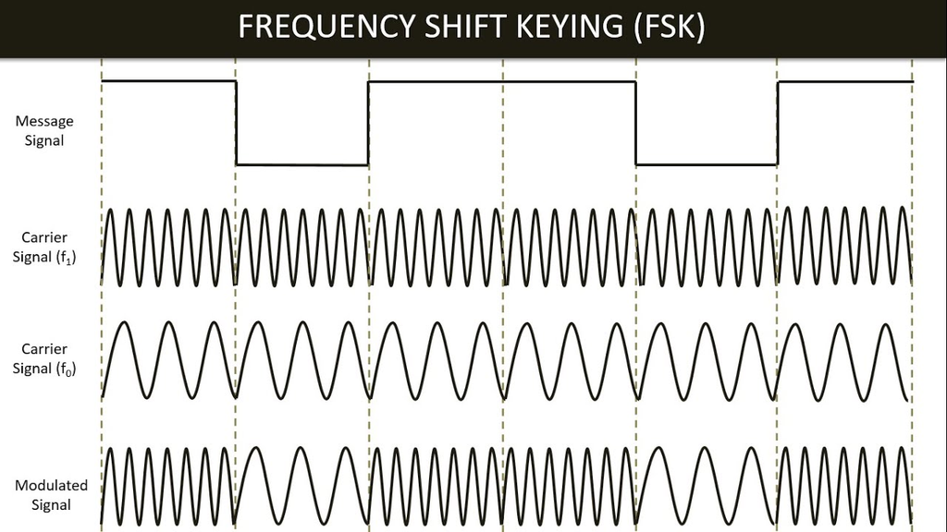
Frequency Shift Keying (FSK)
FSK changes the frequency of the carrier depending on whether the input bit is 0 or 1.
Two discrete frequencies represent logic levels:
At Bit 1 the frequency of output wave increases
At Bit 0 the frequency of output wave decreases
It offers better noise immunity than ASK.
Real-World Example:
Bluetooth uses Gaussian FSK (GFSK) to enable low-power, short-range wireless communication between devices.

Slide 6
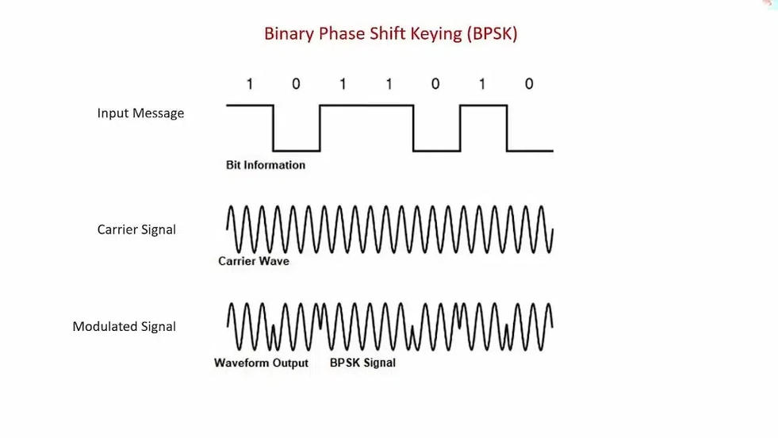
Phase Shift Keying (PSK)
Phase Shift Keying (PSK) is a digital modulation technique in which the phase of a constant-amplitude carrier is changed whenever the input bit changes. In Binary PSK (BPSK):
Bit ‘0’ → Phase = 0°
Bit ‘1’ → Phase = 180°
Each bit transition causes a 180° phase shift, allowing reliable representation of digital data.
Real-World Example:
Wi-Fi uses PSK and higher-order variants (like QPSK, 16-QAM) for high-speed data transmission.
Formula:
s(t)=Acos⁡(2πfct+ϕi)

Slide 7
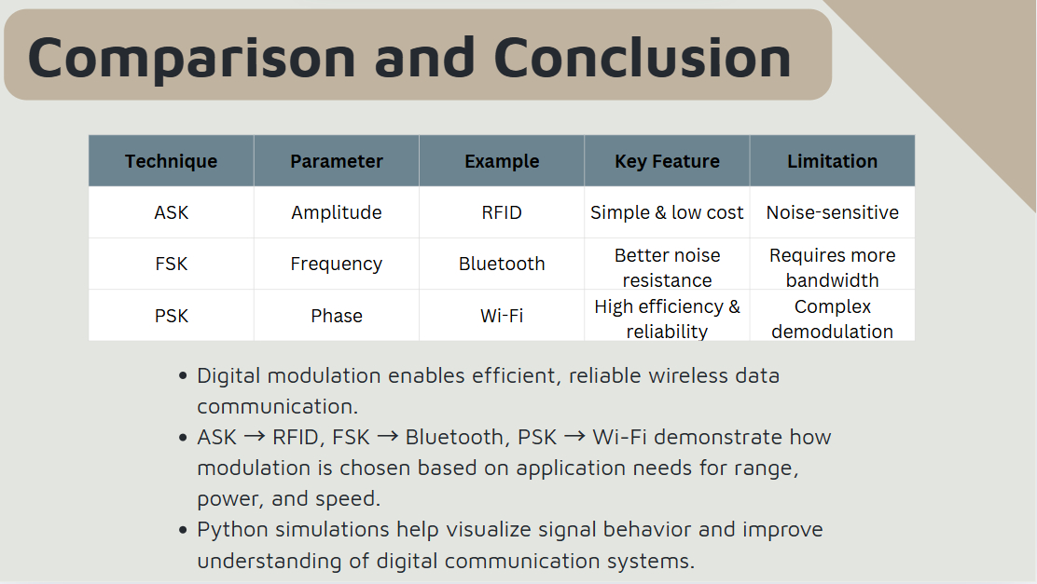
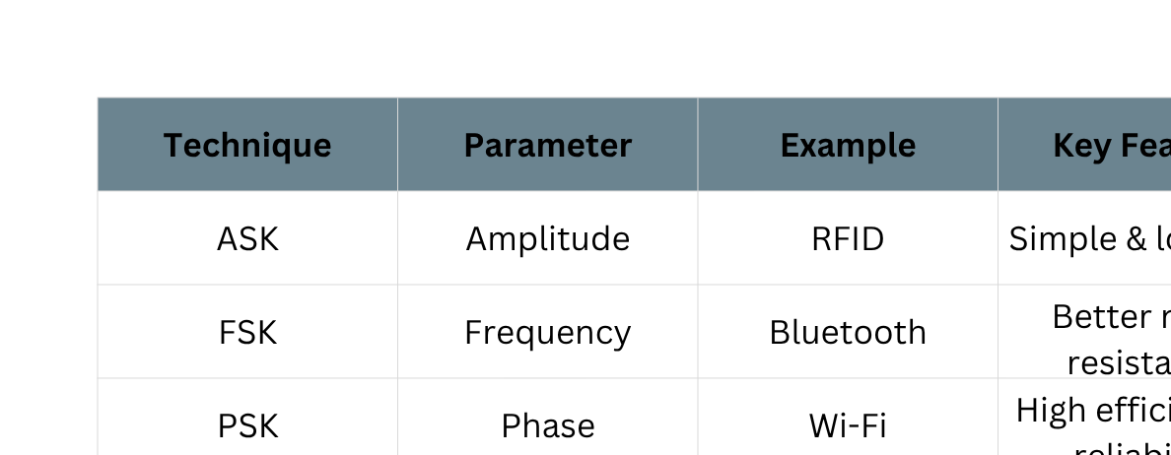
Comparison and Conclusion
Digital modulation enables efficient, reliable wireless data communication.
ASK → RFID, FSK → Bluetooth, PSK → Wi-Fi demonstrate how modulation is chosen based on application needs for range, power, and speed.
Python simulations help visualize signal behavior and improve understanding of digital communication systems.

Slide 8
References
S. Haykin, Communication Systems, 5th Edition, Wiley, 2013.
K. Finkenzeller, RFID Handbook: Fundamentals and Applications, 3rd Edition, Wiley, 2010.
Bluetooth SIG, Bluetooth Core Specification v5.4, 2021.
IEEE Std 802.11-2020, IEEE Standard for Wi-Fi Networks, 2020.
MATLAB & Simulink, Digital Modulation Techniques Tutorial, MathWorks. [Online]. Available: https://www.mathworks.com/help/comm/ug/digital-modulation.html

